Slide 1

Cumberland
County Government
County Benefits
  Aaron Smith, Confidential Assistant, Employee Benefits
Customer Service, Ethics, Training, and Workplace Wellness
  Dr. Cindy Hickman, Ed.D. Director of Training and Development
Department of Personnel and Human Resources

Slide 2
Agenda
Customer Service, Ethics, Training, and Workplace Wellness
Employee Benefits

Slide 3

The Role of a Public Servant

Slide 4


Slide 5

People tend to place more emphasis on how they are treated rather than the quality of the product or service they receive.
A dissatisfied public can:
    Attend County Commissioner meetings
    Call County Commissioners or Governor to complain
    Call the Admin Team to complain
    Bring lawsuits and other legal actions
People tend to place more emphasis on how they are treated rather than the quality of the product or service they receive.

Slide 6

Remember this…no matter how difficult the customer is…
“The customer is the reason you have your job.”

Slide 7

Code of Ethics
No County official or employee shall accept from any person whether directly or indirectly and whether it be himself/herself or through any member of his/her immediate family, or any member thereof, any gift, favor, service, employment or offer of employment or any other thing of value under circumstances…

Slide 8

Code of Ethics
No County official or employee shall disclose confidential information acquired by him/her in the course of his/her official duties or acquired by him/her while employed by the County or use such information to advance the financial or personal interest of himself/herself or any other person.

Slide 9

Code of Ethics
No County official or employee shall willfully disclose to any person, nor use for the purpose of pecuniary gain, any information not generally available to members of the general public which he/she received or acquires during and by reason of his/her official duties.

Slide 10

Code of Ethics
No County official or employee shall represent any private interests for the purpose of personal gain in any cause, proceeding, or application before any County agency or department or in any litigation to which the County is a party.

Slide 11

No County official or employee shall accept employment, engage in any business transaction or make any investment which will be detrimental to the County, in the exercise of his/her official duties, or which will interfere in any manner whatsoever with the discharge of his/her official duties.

Slide 12

CHAIN OF COMMAND
Resolving issues at the lowest possible level and strive to find an equitable solution to any problem at hand.
In most cases this can be achieved at the department level.
If attempts to resolve the issue through this process are unsuccessful, or for situations that may be sensitive in nature, an employee may reach out to the Department of Personnel.
Exception: break chain to report ethics violations, fraud, harassment, etc.

Slide 13
Training
Compliance – Statutory
Required
Recommended

Slide 14
New Hire List of Required Trainings
Orientation PowerPoint for benefits, introduction, and customer service and wellness
Location: http://intranet.co.cumberland.nj.us/
Frequency: Upon Hire and Rehire
Hover over home page, hover on Personnel, scroll down and click on New Hire Orientation
Anti-Bullying Video, provided during Orientation.
Run, Hide, Fight video
Location: http://intranet.co.cumberland.nj.us/
Frequency: Within first week of hire
Instructions to reach video once on website: Hover over home page, hover on personnel, scroll down and click on Workplace Health and Safety
Emergency Action Plan Training (Department)
Contact your supervisor to attend an Emergency Action Plan Training from your leader for your facility.
Communicable Disease Awareness Workplace Training
Location: http://intranet.co.cumberland.nj.us/
Frequency: Upon hire at orientation
Instructions to reach video once on website: Hover over home page, hover on personnel, scroll down and click on workplace health and safety

Slide 15
Implicit Bias and Employee Conduct and Violence in the Workplace, BIS Library NJCE Learning Management System
Location: Live Webinar, J. Montgomery
Frequency: Upon Hire and every other year.
Public Employees Occupation Safety and Health (PEOSH) requirements (listed as PEOSH Safety Training)
Location: http://intranet.co.cumberland.nj.us/
Frequency: Frequency varies depending on the Course Standards/Department requirements
Instructions to reach video once on website: Hover over home page, hover on personnel, scroll down and click on workplace health and safety
Safety Learning Management System (Bistrainer)
You will receive an activation email for your new user account. Once you log with username and new password, you have access to your required safety training webinars. The training Calendar has the list of classes available to you. Your requirements are listed on the PEOSH website according to your facility. You will also receive an email with links for LMS User training and FAQ sheets about the LMS.
Anti-harassment
Location: Legal Department
Frequency: Every two years, Legal Department will contact employees

Slide 16
Leadership Series
Location: Contact Dr. Hickman, cindhi@co.cumberland.nj.us
Frequency: Contact Dr. Hickman if you are in a new Leadership Position
Bullying Video
Location: Sent to New Hires during New Hire Virtual Orientation
Frequency: Once Upon Hire
Departmental On-the-Job Training
Location: Speak to your supervisor
Frequency: Speak to your supervisor
Personnel Action Policies
Policy and Procedure Manual – Cumberland County Intranet
  Social Media Policy (3.14)
  County Acceptable Use Policy (4.23)
Information Technology Policies
Policy and Procedure Manual – Cumberland County Intranet
  Computer Hardware and Support Policy (4.24)
  Password and Remote Access Policy (4.25)
  Mobile Device Management Policy (4.27)
  Data Security and Personally Identifiable Information Policy (4.29)
Knowbe4 Cybersecurity Training
Enrolled Upon Hire
Frequency: Once a year

Slide 17
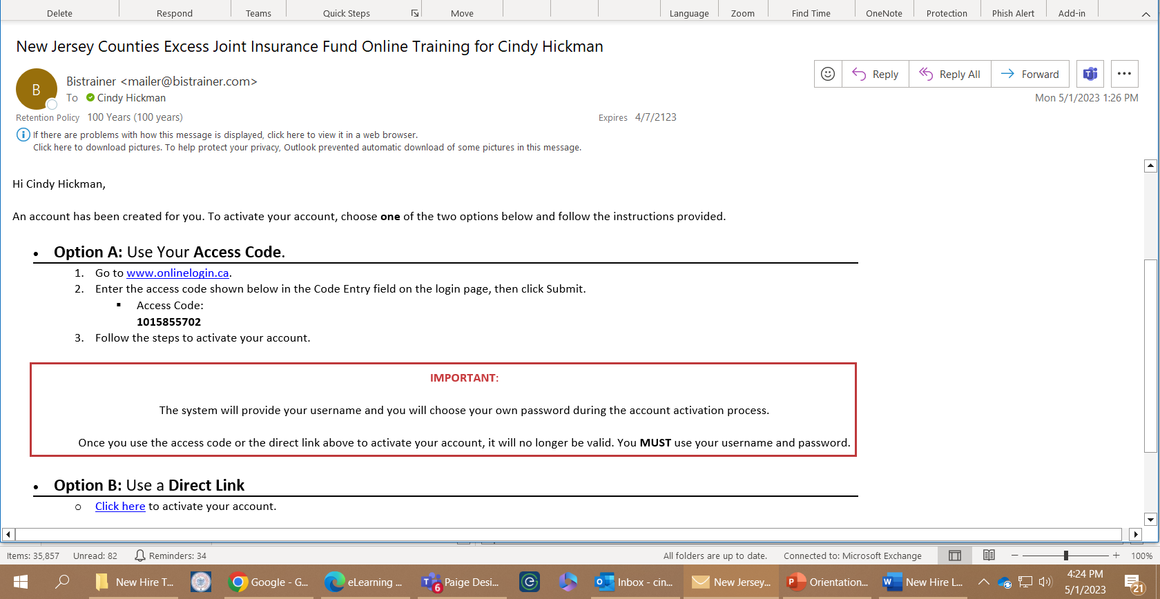

Slide 18
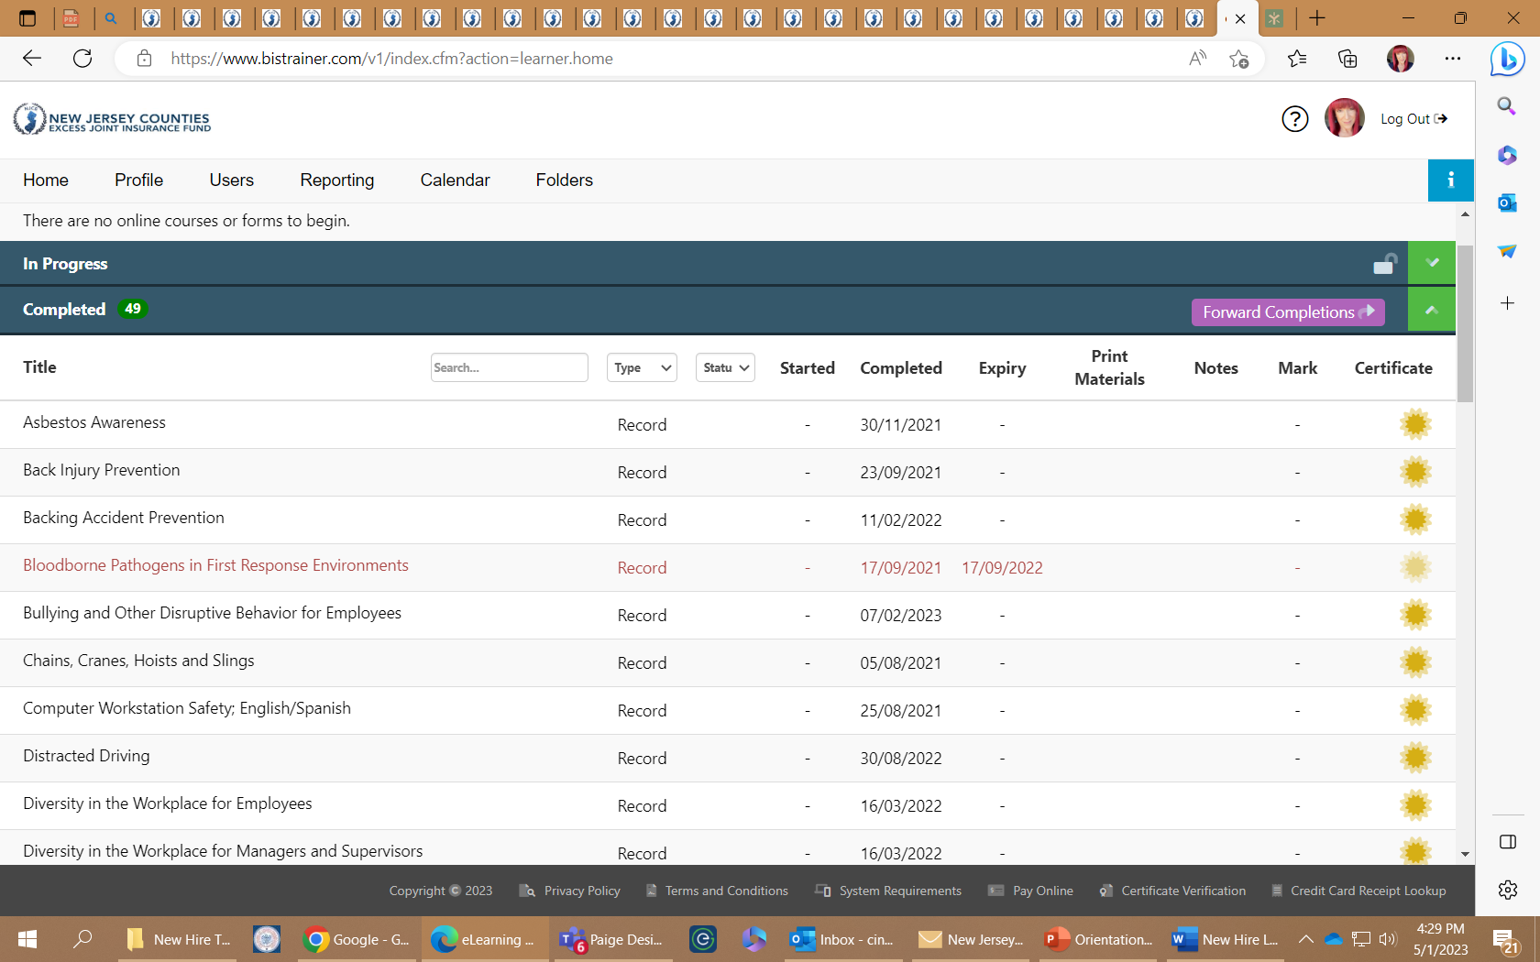

Slide 19
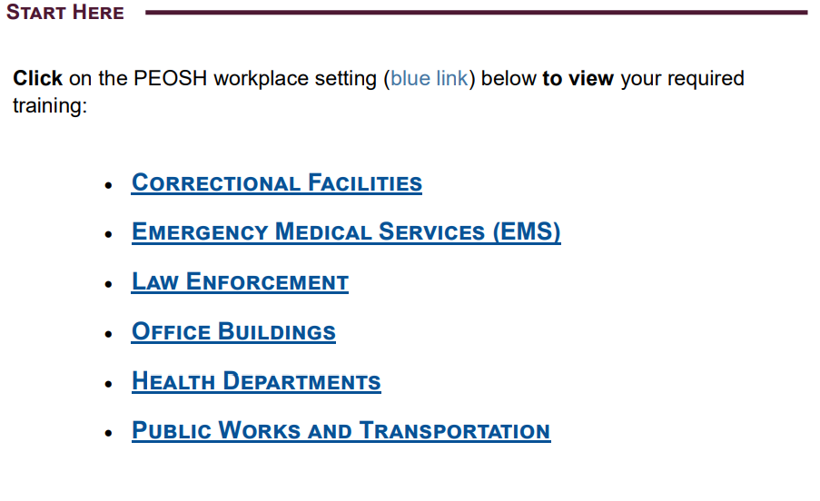

Slide 20
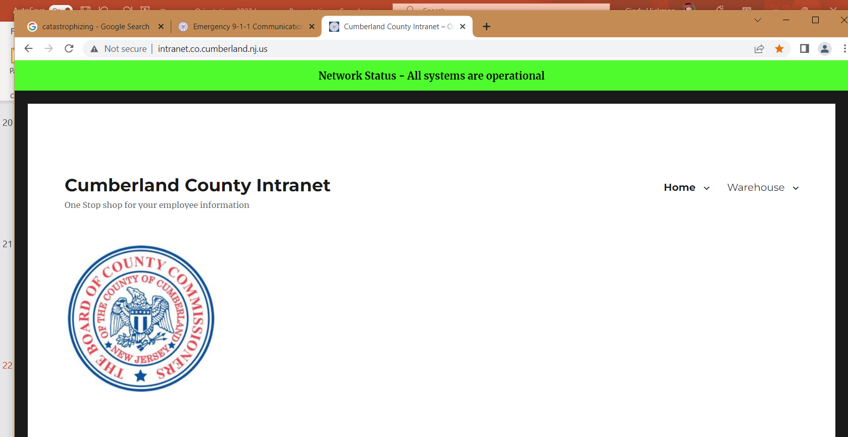

Slide 21



Multi-Dimensional Approach

Slide 22
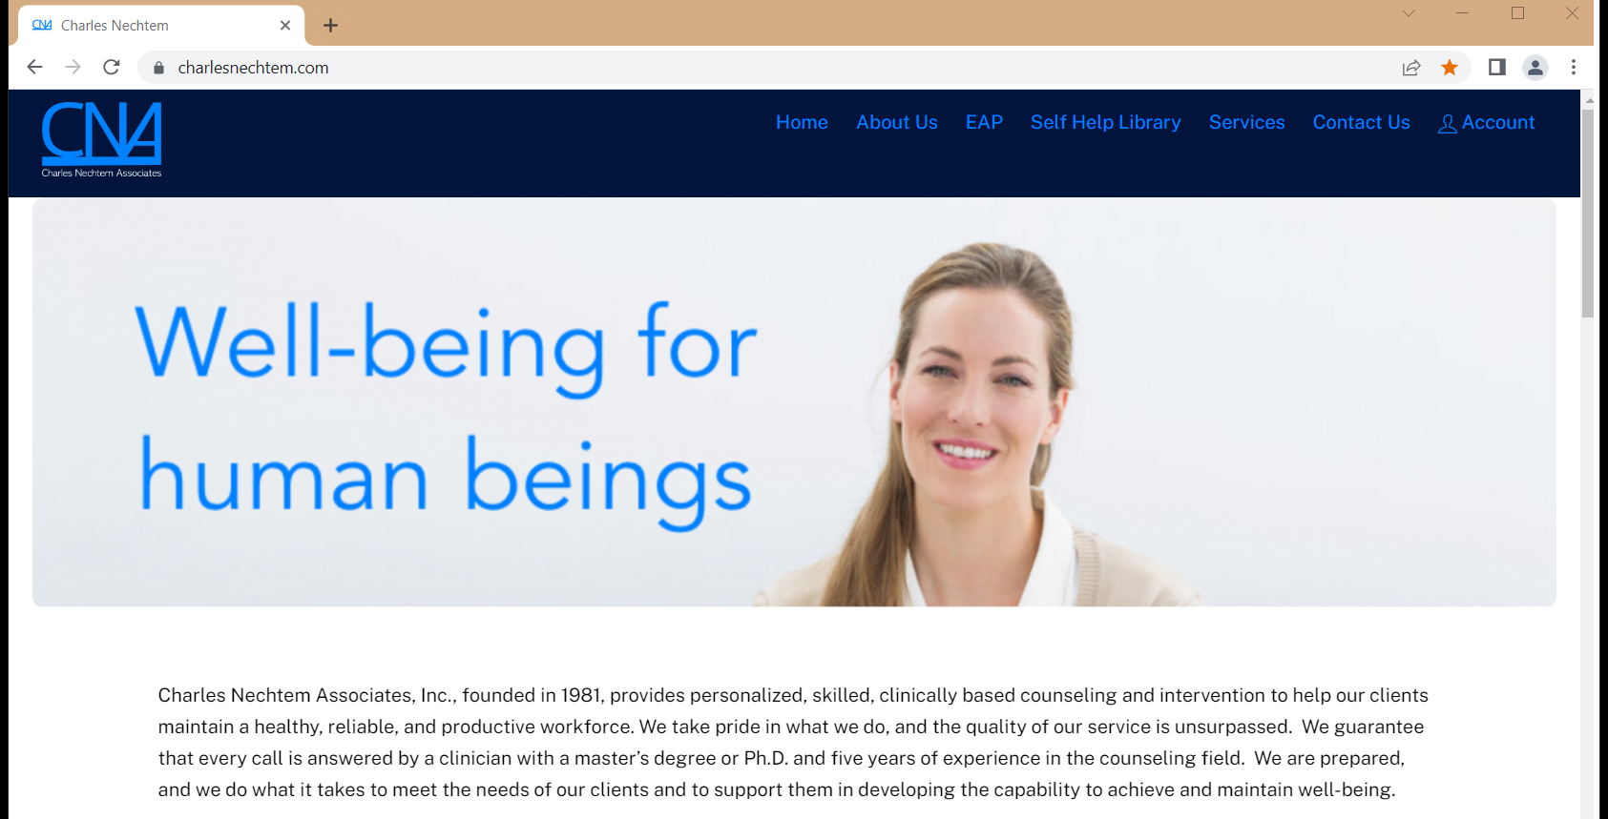

Slide 23
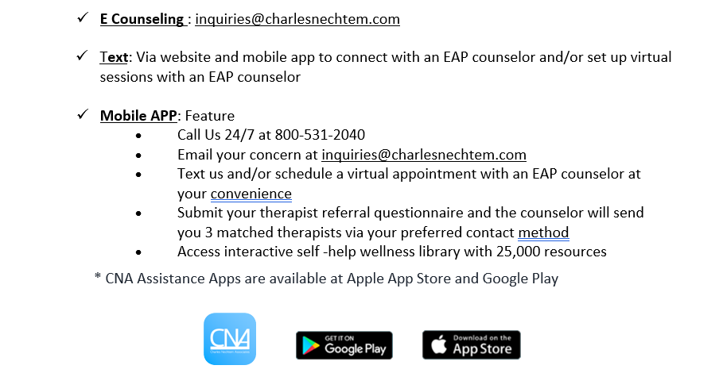

Slide 24
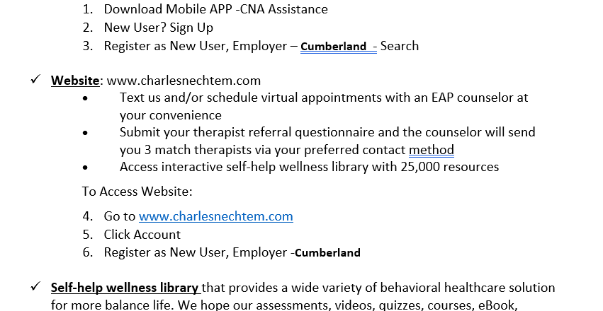

Slide 25



Slide 26



Slide 27


Slide 28


Slide 29

New Hire Orientation Feedback Survey
After orientation you will receive an email with a brief survey about your experience today.

Slide 30

Contact Information
Dr. Cindy Hickman, Ed.D.
  Director of Training and Development
cindyhi@cumberlandcountynj.gov
856 238-6799

